Slide 1

Business Insight 360: Transforming Data into Actionable Insights
Atliq Hardware's Journey to Data-Driven Decision Making

Slide 2
Problem Statement:
AtliQ Hardware, a rapidly growing company in the electronic goods market, specializes in products such as printers, mice, PCs, and keyboards. They serve prominent customers like Croma, Flipkart, and Amazon across various locations. Despite their growth, AtliQ faced significant losses during their expansion into Latin America due to decisions made based on surveys and intuition.
To overcome this challenge and compete effectively with major players like Dell, AtliQ has decided to hire a data analytics team to drive data-driven decision-making. The existing reliance on Excel for data analysis is inadequate for their growing needs, prompting the need for a more robust solution

Slide 3
Key Challenges:
Expansion Losses | Competitor Pressure | Current Limitations
Financial losses in the Latin American market. | Competitors like Dell have advanced data analytics teams. | Reliance on Excel for data analysis.
Decisions based on surveys and intuition. | Need to analyze customer demographics and market trends. | Inability to handle large datasets and complex analytics.

Slide 4
Project Goals:
Implement Power BI | Data-Driven Decision Making | Competitive Advantage | Quantitative Benefit
Transition from Excel to Power BI for advanced analytics. | Enable informed strategic decisions based on data. | Equip AtliQ to compete with industry leaders. | Deliver a 10% incremental profit.
Create comprehensive dashboards and reports. | Improve decision accuracy and reliability. | Provide insights into customer demographics and sales trends.

Slide 5
Expected Outcomes:
Strategic Growth | Enhanced Business Insights | Competitive Edge | Improved Transparency
Improved understanding of market trends and customer behavior. | Data-driven strategies to support expansion and mitigate risks. | Strengthened market position against competitors. | Enable data-driven decision-making across markets and functions.
Identification of profitable opportunities and potential risks. | Increased efficiency in decision-making processes. | Advanced analytical capabilities to drive business growth.

Slide 6
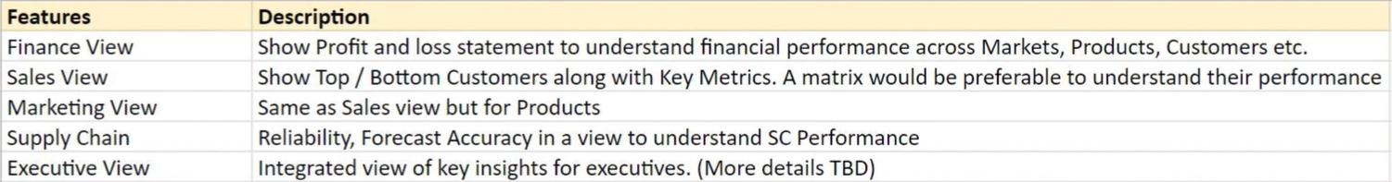
Dataset Details:
Excel file: Outlining the report features.
PDF Files: Mockup/Rough Sketch of Dashboard. SQL dump files: Provides the gdb041: Contains tables for customers, markets, products, forecasts, and sales. gdb056: Contains tables for freight cost, gross price, manufacturing cost, and invoice deductions.

Slide 7
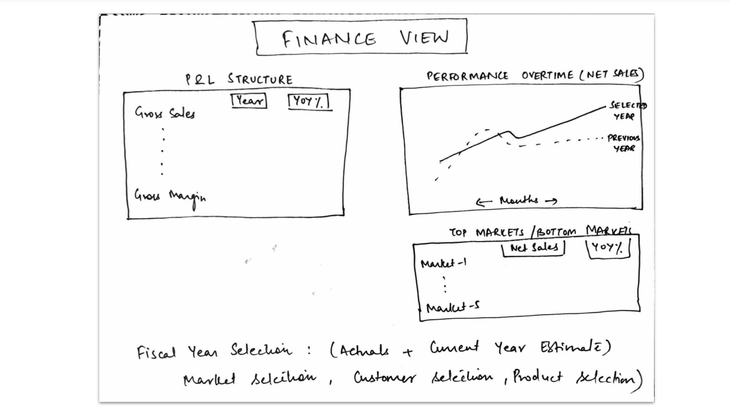
Finance View Mock-up Dashboard:

Slide 8
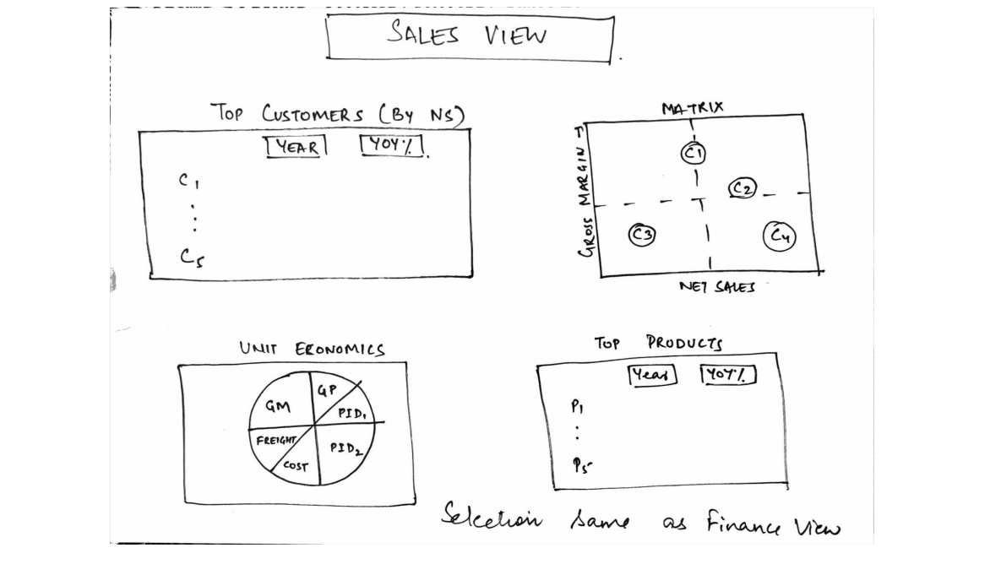
Sales View Mock-up Dashboard:

Slide 9
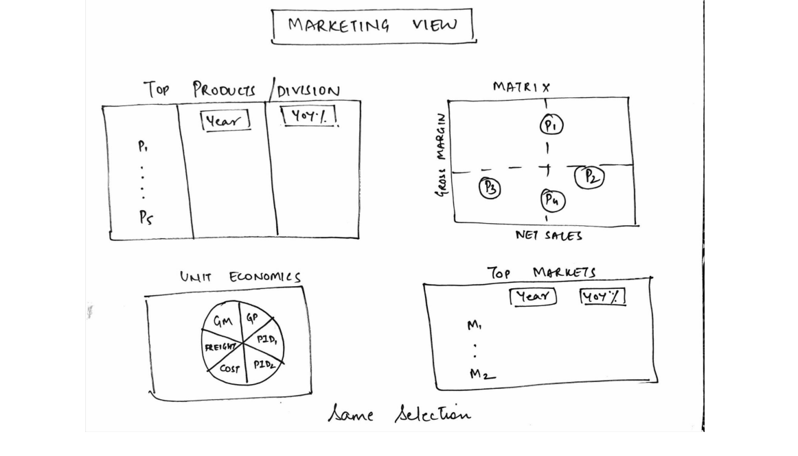
Marketing View Mock-up Dashboard:

Slide 10
Marketing View Mock-up Dashboard:

Slide 11
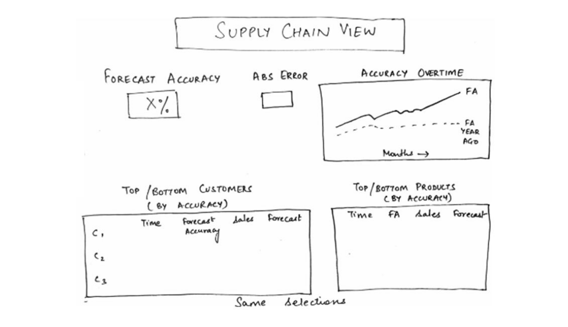
Supply Chain View Mock-up Dashboard:

